Slide 1
Comprehensive Digital Marketing
Project Work on
FORTIS HEALTHCARE INSTITUTE

Slide 2
TEAM MEMBERS
1. MADEM SATHVIKA SARVANI
(Team Leader)
2. GEND PRAKASH
3. DHARMALA AKHIL REDDY
4. ABOTHU SRAVANI
5. KADUPU SUDHEER

Slide 3
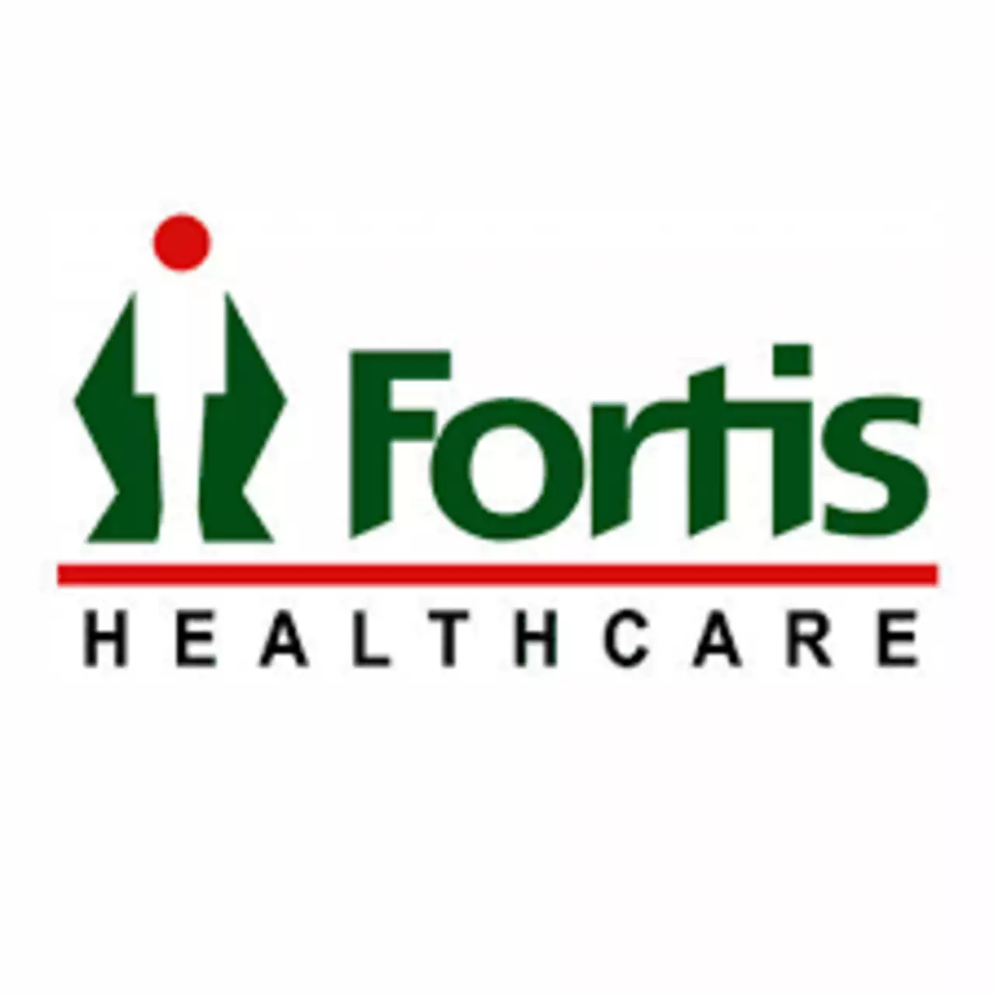

Slide 4

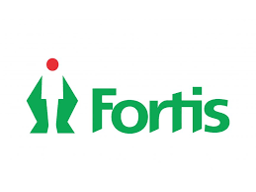
Part 1: Brand study, Competitor Analysis & Buyer’s/Audience’s Persona
Research Brand Identity: Study the brand's mission, values, vision, and unique selling propositions (USPs).
BRAND/TITLE FOR THE PROJECT: FORTIS HEALTHCARE INSTITUTE
Founded : 1996
Founder : Shivinder Mohan Singh
Industry Type : Public Healthcare
URL’s :
Logo :
Brand Colour: red & green

Slide 5
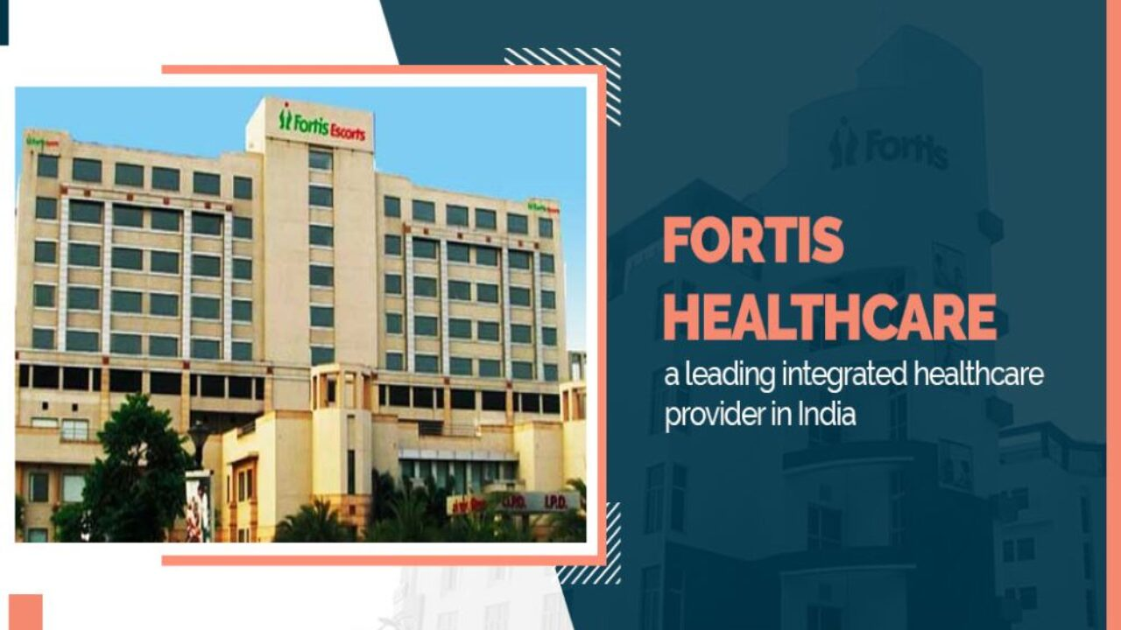
Mission/Value : To create a world class integrated healthcare delivery system in India, entailing the finest medical skills combined with compassionate patient care
Net worth :$990 million
Head Quarters :Gurgaon/Gurugram, Haryana, India.
USP : Fortis is an household name in India, Known for our integrated healthcare services ranging from primary to quaternary care and a wide range of ancillary services.
Brand slogan/Tagline: “ To be a globally respected healthcare organization known for clinical excellence and distinctive patient care”.
Target audience : which are extremely vast and diverse
Rating : 04/5
Customer review : happy & healthy (satisfied)

Slide 6
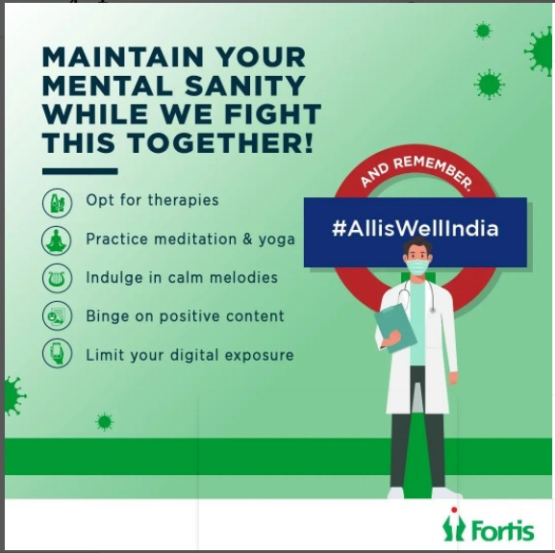


Part 1: Brand study, Competitor Analysis & Buyer’s/Audience’s Persona
Analyze Brand Messaging: It has an substantial presence on twitter, Facebook , You tube and Instagram which created a strong impact on this effective campaigns like all is well , covid expert group , attack the attack , health tips.

Slide 7


.
Examine the brands tagline : “ voice of hope, greater care, clinical excellence and distinctive patient care”.
Tagline description: “voice of hope” refers to making a positive change in someone’s life who ever visits the institute seeking for help.
“Greater care” & “ excellence patient care” refers to changing a persons into a better person from physical illness or mental illness.

Slide 8


Part 1: Brand study, Competitor Analysis & Buyer’s/Audience’s Persona
Competitor Analysis:
Competitor 1: Apollo Hospitals
USP: The cornerstones of Apollo’s legacy are its unstinting focus on clinical excellence, affordable costs, modern technology, and forward-looking research & academics.
Founded year: 1983
Online communications: www.apollo24/7.com
it is an easy way to communicate through online
and can also get the instant solution or results through
connection with apollo.
Overall ranking: 1st place in the market.

Slide 9


Competitor 2: Max healthcare
USP: committed to the highest standards of medical excellence, patient care scientific knowledge and medical education and our vision is to be the most well regarded healthcare provider in India .
Founded year:2001
Online communications: www.maxhealthcare.in
max healthcare doesn’t change any money while
consulting through online. Communication is way
to share thoughts and spreading the knowledge about
our healthcare.
Overall ranking : 2nd place in the
market.

Slide 10

Competitor 3: Global Health
USP: Their healthcare approach is holistic, covering not only patients medical needs but also social, economical, and environmental factors that impact their health.
Founded year:1948
Online communications : www.globalhealth.in
organizations can offer solutions and innovations
by raising awareness and visibility of health issues and
challenges faced by the populations they serve.
Overall ranking: 5th place in the market.

Slide 11

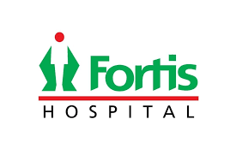

Competitor 1
Competitor 3
Competitor 2

Slide 12
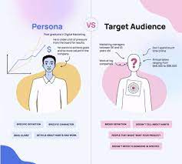
Part 1: Brand study, Competitor Analysis & Buyer’s/Audience’s Persona
Buyer's/Audience's Persona: Clearly define the target audience for the chosen brand. Consider demographics, psychographics, behaviours, and interests.
Demographics: Fortis healthcare
has 23,000 employees
59% of employees are women
41% are men
The most common workers at fortis healthcare is Asian (43%).

Slide 13
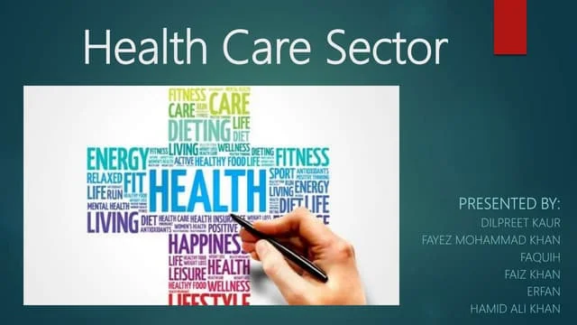
Professional information:
Largest healthcare providers and any problem will be treated.
Corporate healthcare located in more than 20+ places.
4000 operational beds and 400 diagnostic centers .
Firm revenue ranging from ₹193,585 crore (US$24 billion).
Values and Fear:
Patient centricity
Teamwork , ownership
Integrity , innovation
Not let the health of the planet take a backseat
Psychographics:
A widely used segmentation method that classifies America’s adult population into eight distinctive subgroups: innovators, Thinkers, Achievers, Experiencers, Believers, Strivers, Makers, and Survivors.

Slide 14

Psychographic segmentations are effective because people in the same demography can have different psychographic characteristics based on individual life experiences and growing up environment.
Pricing:
Fortis has the highest other expenses (28% of revenue) largely due to higher rentals, advertising costs and maintenance charges, and an uptick in legal expenses, provisions and housekeeping expenses.
Behaviour & Interest :
Mentally and psychically they are good at connecting with the
customers whoever visits the healthcare institute.
Interests are to make the customer healthy , fit and happy

Slide 15
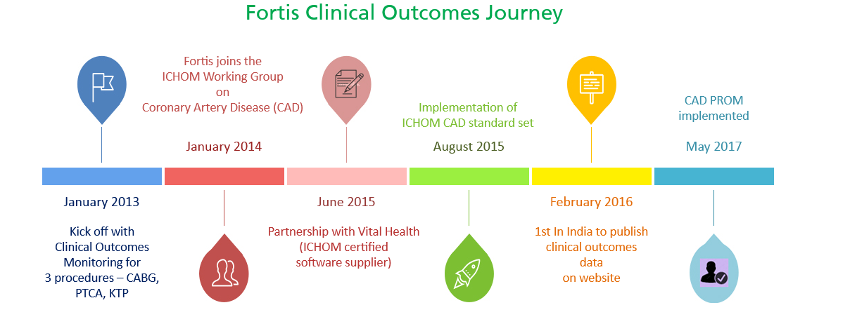
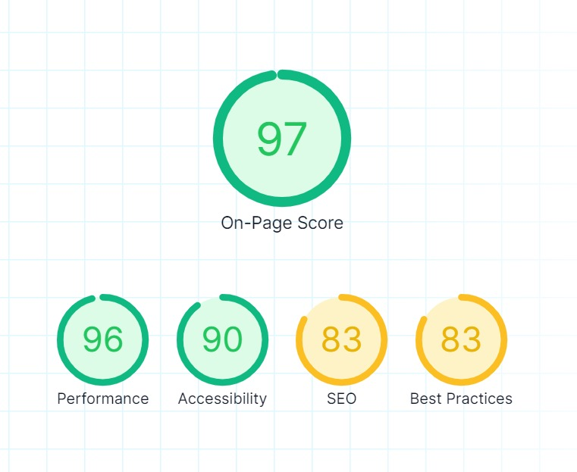
Part 2: SEO & Keyword Research
SEO Audit: Do an SEO audit of the brands website
Website called www.fortishealthcare.com

Slide 16

KEYWORD RESEARCH:
keyword research involves identifying relevant keywords and phrases related to a particular topic or business to improve search engine optimization(SEO) and attract targeted traffic. For the “ Fortis healthcare ” a prominent healthcare institution, the keyword research would focus on terms related to its services, locations, specialties, and other relevant aspects. Below are some potential keywords related to Fortis healthcare.
Find a doctor in fortis
Doctors hospitals
Medical center near me
Medical doctor in fortis
Medical services in fortis
fortis
fortis hospital
fortis hospital Shalimar Bagh
fortis hospital Gurgaon
fortis hospital Kolkata

Slide 17
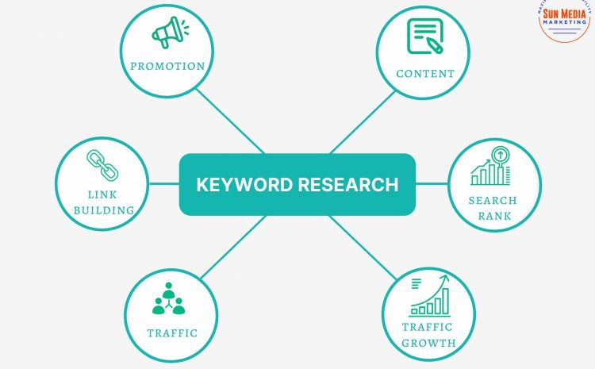
JOB’s in Fortis hospitals
Best hospitals
medical doctor
Memorial healthcare system
Hospital private
Medical city
Patient care
Medical group
Best hospitals near me
Best hospitals in the world
Heart hospitals
Healthcare career
the actual key word selection will depend on the specific goals on the SEO.

Slide 18
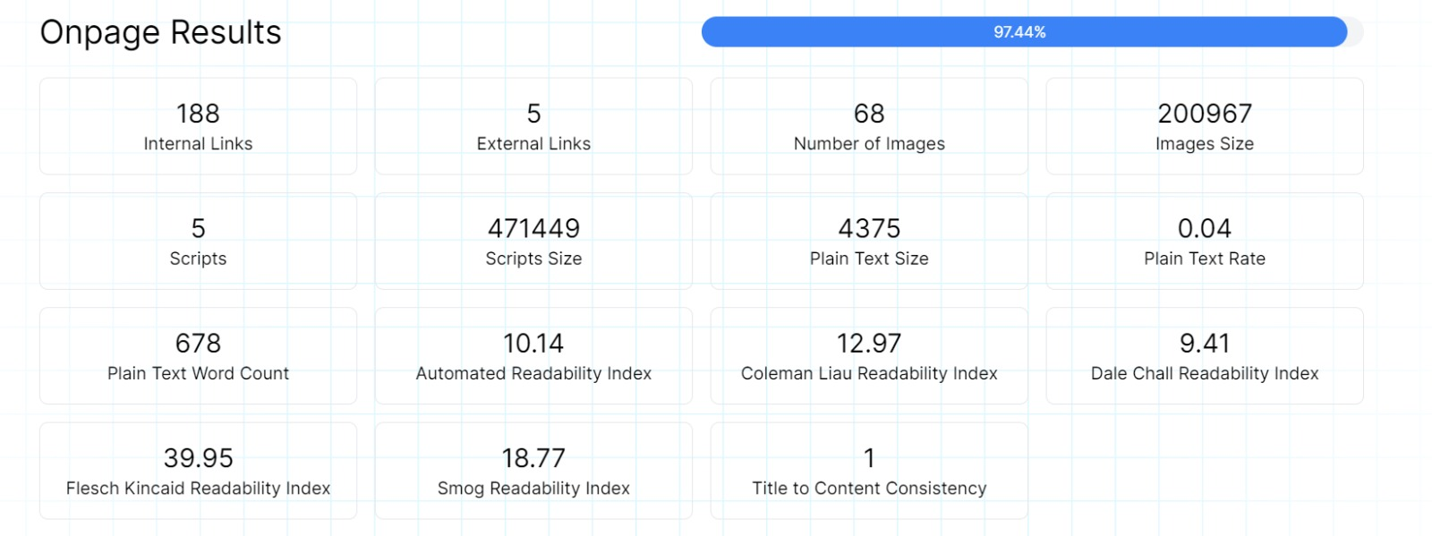
ON PAGE OPTIMIZATION
Fortis healthcare is the leading multi speciality healthcare Health care unit with best-in-class treatment for heart, knee replacements, liver transplant, heart, diabetes, cancer, kidney etc.
Global Rank
#86,864
^21,414
Country Rank (INDIA)
#6,652
^1,148
Category visit
#50
^11
Total visits: 549.7k
Bounce rate: 55.12%
Pages per visit: 4.35

Slide 19
Average visit duration: 00:02:58
Company: Fortis Healthcare, founded year- 2001, Employees- 10001
HQ- INDIA - Gurgaon , Annual revenue- $500.0M - $1.0B , industry-health>health
fortishealthcare.com Ranking
Website ranking helps evaluate the value of a business. Over the last three months, fortishealthcare.com global ranking has increased from 119,582 to 86,864.
fortishealthcare.com Traffic and Engagement Analysis
Fortishealthcare.com traffic has increased by 26.75% compared to last month
Geography & Country Targeting
Which countries sent the most traffic to fortishealthcare.com lately? Where is their core audience from? Last month India was the top country sending desktop traffic to fortishealthcare.com

Slide 20
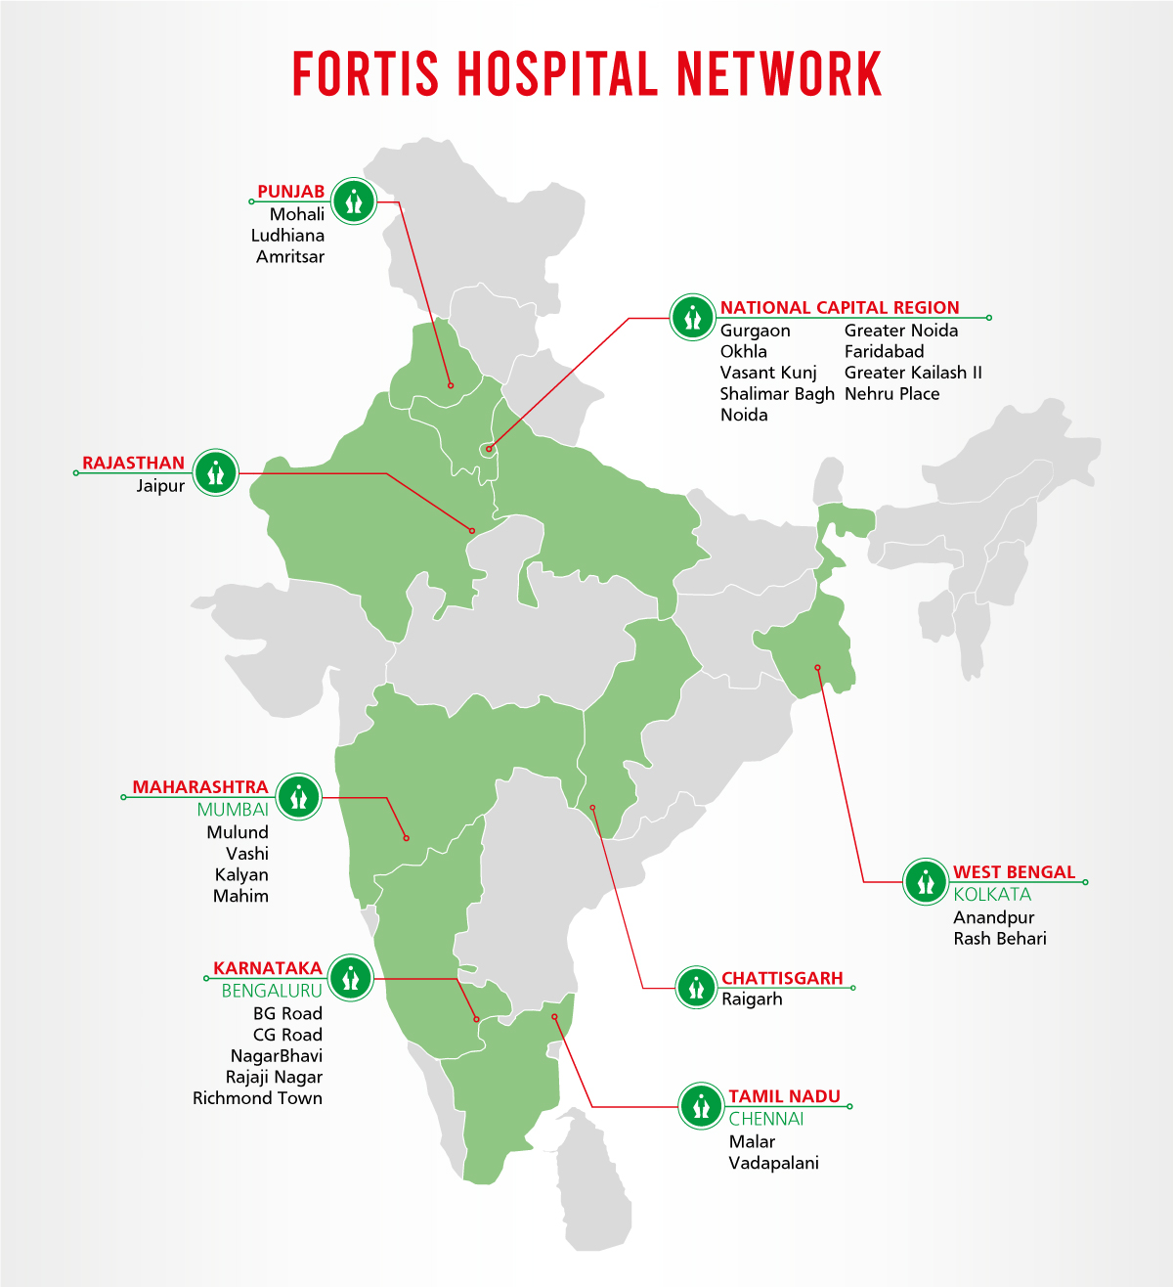
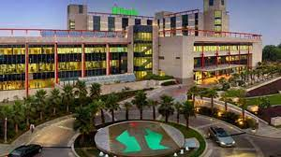
Top countries:
it is one of the largest healthcare organization in the country with 24/7 healthcare facilities. 4,300 operational beds and 400 diagnostic centres
INDIA
UNITED STATES
UNITED KINGDOM
UNITES ARAB EMIRATES(UAE)
NEPAL
SRI LANKA
OTHERS.

Slide 21
Part 3: Content Ideas and Marketing Strategies
Content Idea Generation & Strategy: Create a content calendar for the remaining month of July by brainstorming content themes, exploring various formats like blog posts, videos, infographics, podcasts, and interactive quizzes, and scheduling publication dates mainly on Facebook & Instagram. And include the strategy, aim and the idea behind these posts and story
Content Calendar Example (Try creating a table for the month of July)

Slide 22
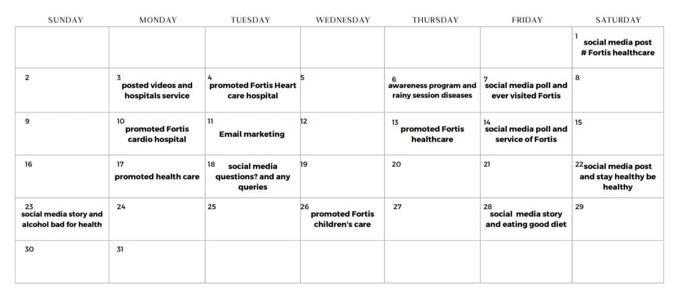
CALENDAR :
JULY 2023

Slide 23
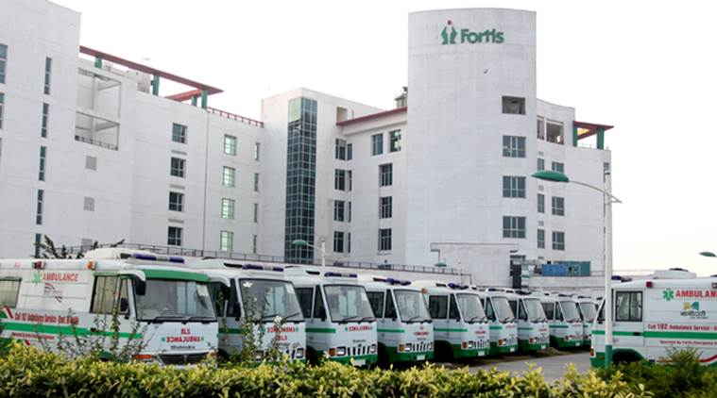
Part 3: Content Ideas and Marketing Strategies
Content ideas:
creating social media websites updating all the information like achievements etc. where picture information attracts more customers than the written content. Following all the technological updates and changing the information about fortis healthcare.
Fortis Memorial Research Institute, Gurugram bagged 4 awards in Bone Marrow Transplant, Medical Oncology, Surgical Oncology and Neurosciences; Fortis Escorts Heart Institute, Okhla bagged 2 awards in Paediatric Cardiac Sciences (Cardiology and Cardiac Surgery) and Interventional Cardiology and Fortis Hospital, Noida bagged 1 award in liver transplant.

Slide 24
Marketing Strategy:
Fortis Healthcare analyzes the brand with the marketing mix framework which covers the 4Ps (Product, Price, Place, Promotion). These business strategies, based on Fortis Healthcare marketing mix, help the brand succeed in the market. Let us start the Fortis Healthcare Marketing Strategy & Mix to understand its product, pricing, advertising & distribution strategies.
Product: Fortis Healthcare and hospitals are one of the most well equipped medical Centers & hospitals which are spread across India. Fortis healthcare offers excellent medical services like complex organ transplant surgeries, Orthopedics, Mother and child health, Oncology, Cardiac Sciences etc.
Price: Fortis healthcare is considered as a premium healthcare service provider as it competes in the same segment as that of Apollo hospitals and Max hospitals with its offerings focusing on patient experience by including world-class healthcare services and new technology to justify its higher pricing.

Slide 25


Place: Fortis operators its hospitals across several tier1 and tier2 cities in India such as Delhi, Amritsar, Kolkata, Mumbai, Mohali, Ludhiana, Jaipur, Chennai, Kota, Bengaluru, Gurgaon, Noida, Faridabad, and Odisha. Its head office is situated in Unitech business park in Gurgaon, Haryana.
Promotion: Fortis promotes its services through traditional as well as digital media with newspaper adverts, medical periodicals, you tube and tv adverts. It has launched several awareness campaigns to urge people to take control of their health such as NDTV-Fortis healthcare4u campaign and spread cancer awareness campaigns with its most recent campaign focusing on urging people for organ donation for needful patients. It spreads brand awareness through these campaign as well as celebrity endorsements.
.

Slide 26
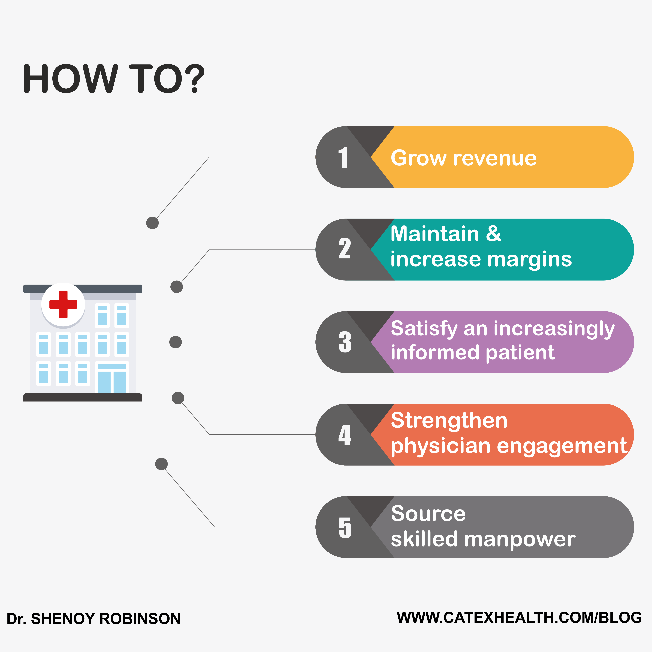
Challenges encountered:
Financial issues.
Government mandates.
Patient safety and quality care.
Staffing concerns.
Patient satisfaction.
Access to care.
Doctor-related issues.
Population health management.
Lessons learned:
Patient Centricity, Commit to 'best outcomes and experience' for our patients. ...Integrity. Be principled, open and honest. ...Teamwork. Proactively support each other and operate as one team. ...Ownership. Be responsible and take pride in our actions. ...Innovation. Continuously improve and innovate to exceed expectations.

Slide 27
Part 4: Content Creation and Curation (Post creations, Designs/Video Editing, Ad Campaigns over Social Media and Email Ideation and Creation)
Instagram Story
Utilize the Stories feature on Instagram for three consecutive days. Share behind-the-scenes glimpses, polls, quizzes, or sneak peeks etc to encourage audience participation. Once uploaded use the story highlight feature on Instagram and save the 3 story with an appropriate name for each. Note: Once done monitor the performance of the posts and Stories using the insight tool and analyze the engagement metrics (likes, comments, shares, impressions, etc.). Based on the analysis, mention the strategies and areas for improvement.

Slide 28


Instagram Story:
creating an new account with the name of Fortis healthcare and the next step is to give the mail id and the conformation code will be given in the account and next creating an strong password then accepting their terms and conditions the account will be opened.
creating 3 different stories with 3 different glimpse like –
Have you ever visited our hospitals
Do you have any queries
How is our hospital service
and segregating all the likes, shares, comments etc. from the story highlight saving all the three stories and adding to the presentation.

Slide 29
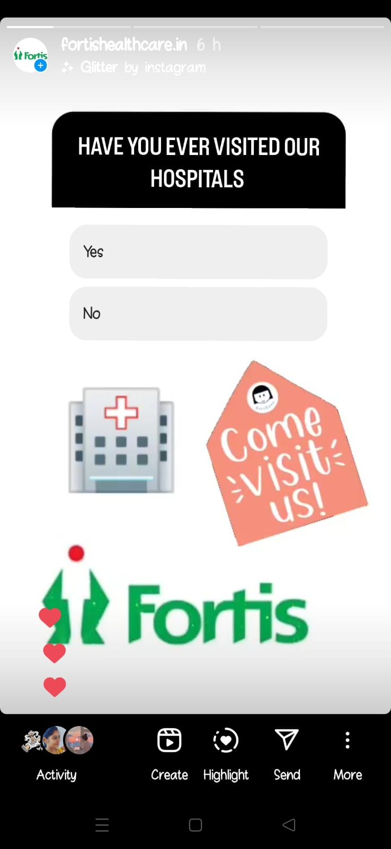
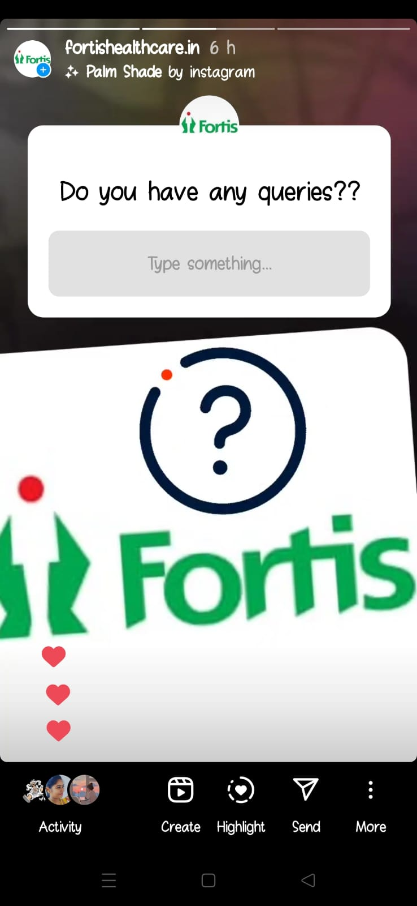
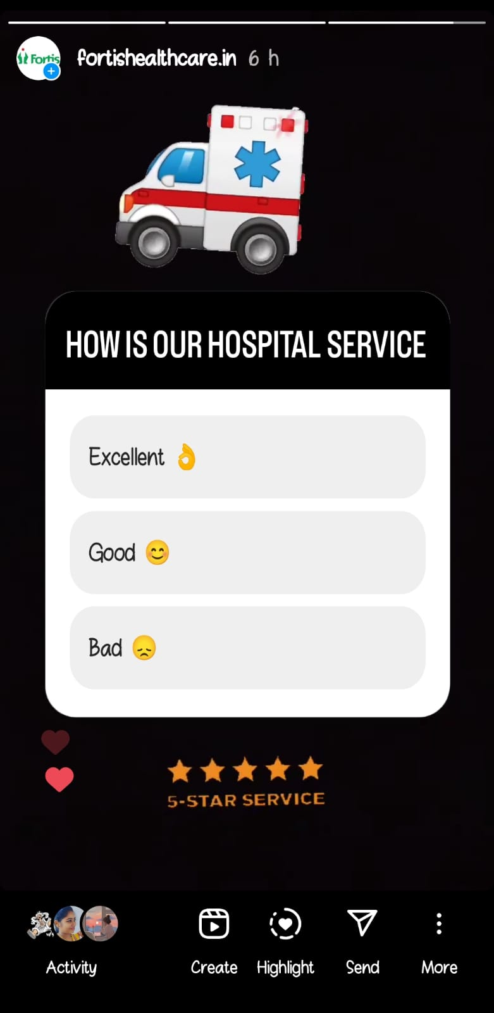

Slide 30
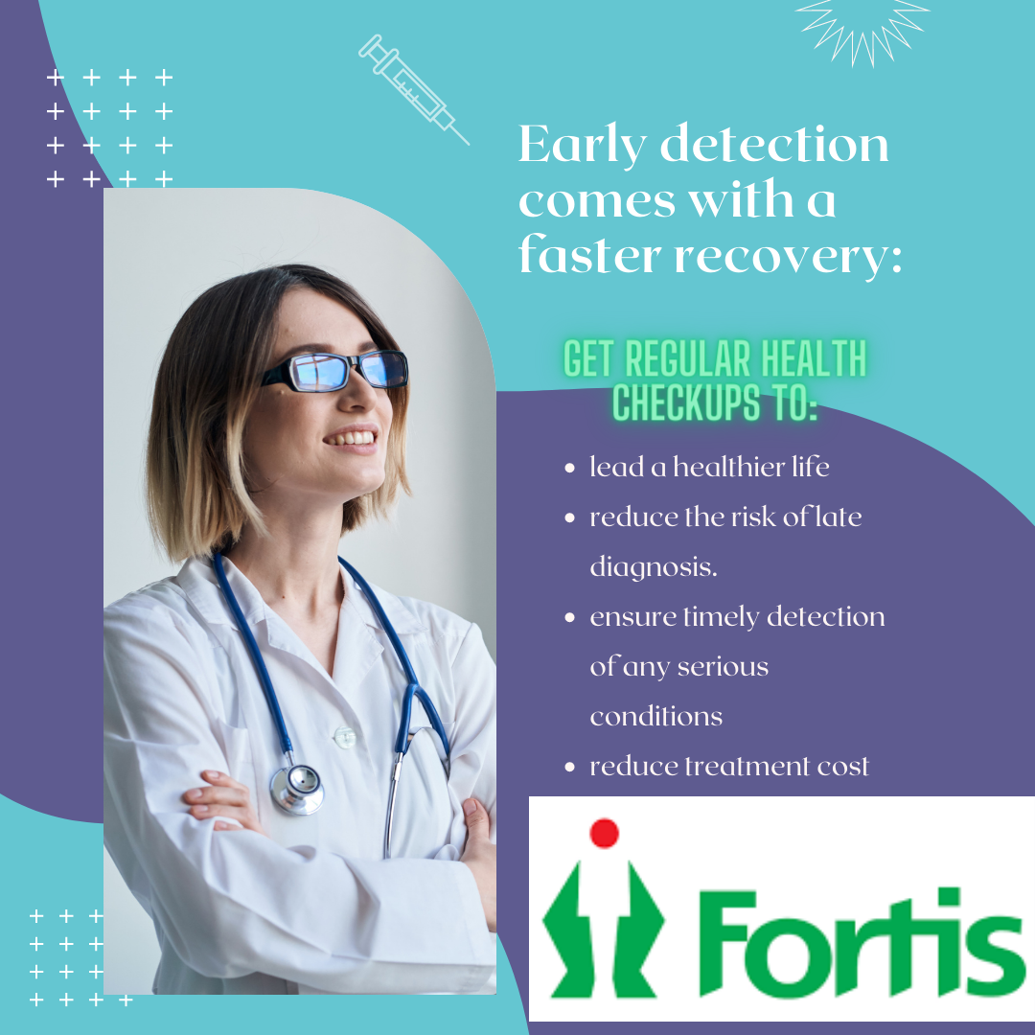

Post creations:
Aim: To bring more customers
Idea : Making people know about the healthcare
Topic : Taking care of your health

Slide 31
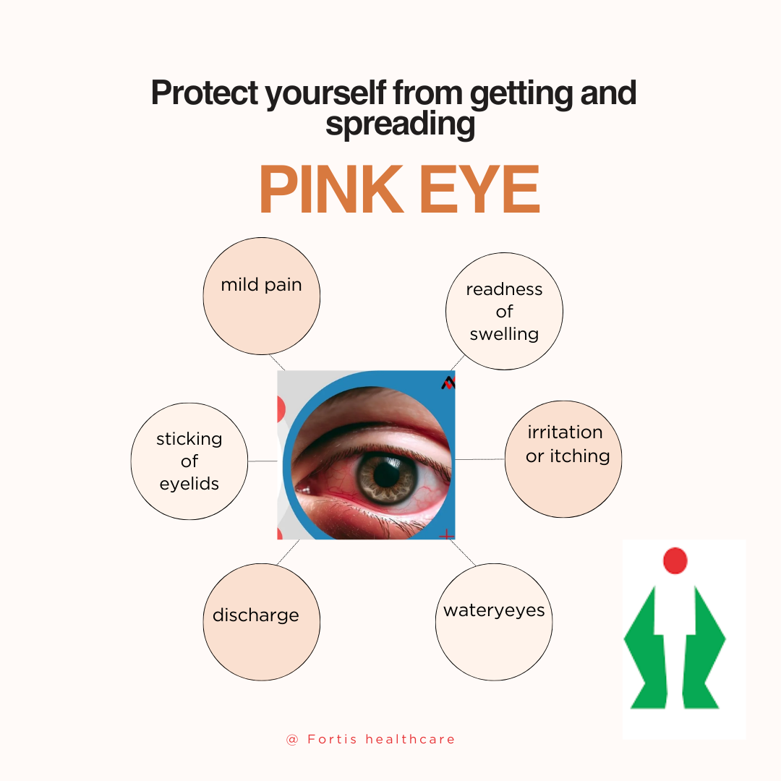
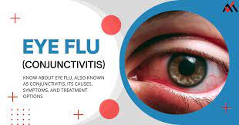
Post creations:
Aim: To ensure the present problems faced by the customers
Idea : make people get tested about their symptoms
Topic : safety of a customer.

Slide 32
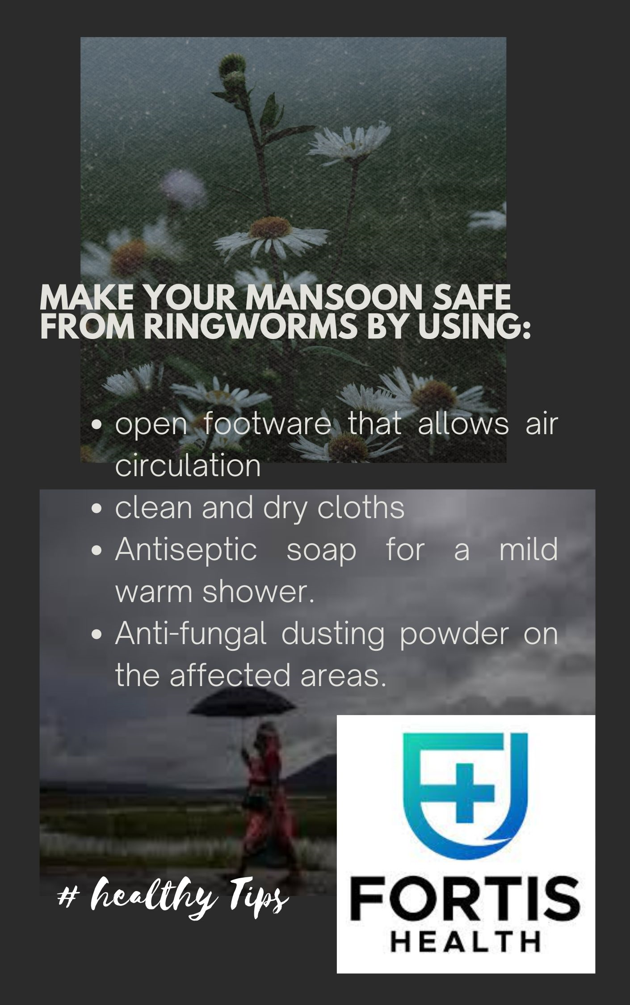

Post creations:
Aim: To gain customer’s loyalty
Idea : giving knowledge to the customer’s about the season
Topic: How Fortis take care of customers

Slide 33
Part 4: Content Creation and Curation (Post creations, Designs/Video Editing, Ad Campaigns over Social Media and Email Ideation and Creation)
Designs/Video Editing
Design Tools Familiarization (use Canva for creating visually appealing graphics)
Video Creation: Utilize VN or any video editor of your choice to create videos related to the chosen topic.

Slide 34
Designs/Video Editing:
Google drive link:
https://drive.google.com/file/d/1bNcsEgwmOR74Ne0AsR7VkCh_GPLgQVPd/view?usp=drivesdk

Slide 35
Part 4: Content Creation and Curation (Post creations, Designs/Video Editing, Ad Campaigns over Social Media and Email Ideation and Creation)
Social Media Ad Campaigns
Ad Campaigns over Social Media:
Come up with 3 ad campaigns each covering one of the mentioned goals:
brand awareness
driving website traffic
generating leads

Slide 36
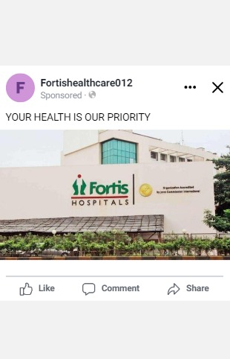
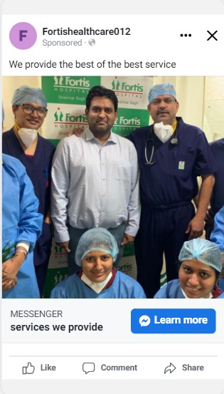
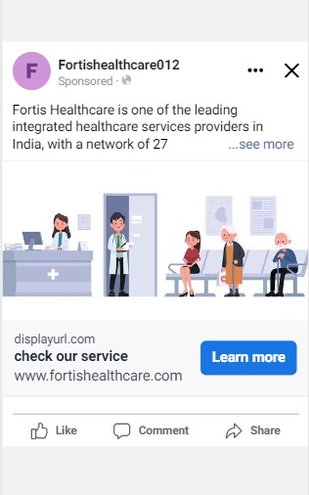
Ad Campaigns over Social Media:
1. Awareness
2. website traffic
3. Lead generation

Slide 37
Part 4: Content Creation and Curation (Post creations, Designs/Video Editing, Ad Campaigns over Social Media and Email Ideation and Creation)
For every campaign clearly define:
Advertising Goals: increasing brand awareness, driving website traffic, or generating leads.
Audience Targeting: Define the target audience for the ad campaigns based on demographics, interests, and behaviour.
Ad Creation: Create visually appealing ad creatives, compelling ad copy and relevant call-to-action.

Slide 38


Advertising Goals:
To create a world-class integrated healthcare delivery system in India, entailing the finest medical skills combined with compassionate patient care. To be a globally respected healthcare organization known for Clinical Excellence and Distinctive Patient Care.
To increase brand awareness by reaching a diverse audience and boosting visibility.
This could attract potential customers who may need to become more familiar with the brand.

Slide 39
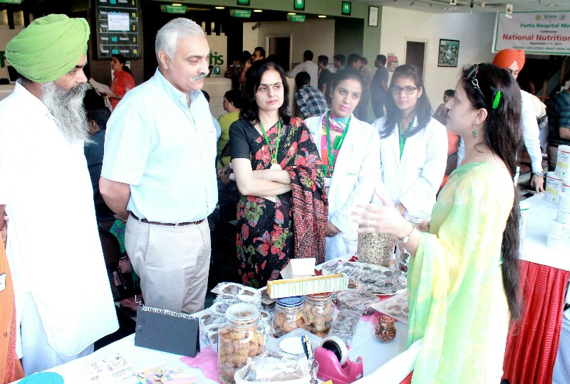
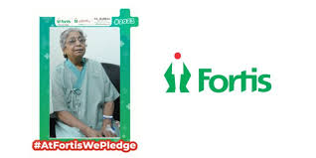
Audience Targeting:
What was once through word of mouth, people now rely on the internet to find the best doctors and hospitals in their city. Hence, it has become increasingly important for hospitals and healthcare providers to be online to showcase their services to provide people with pertinent information.
Healthcare groups such as Fortis understand the growing significance of having an exceptional digital presence to engage with their target audience. While many have a strong online buzz, Fortis has been relatively more successful in capturing the online community’s attention than its competitors.

Slide 40
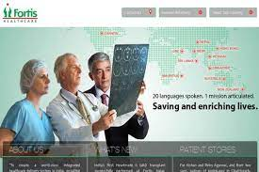

Ad Creation:
Take an image of a group of doctors. Who is wearing white coats and attending the patents?
Ad copy: At Fortis healthcare, we prioritize your health. We offer many services to help you stay healthy. From preventive care to specialized treatment, we're here to help you live your healthiest life.
Call to action:
Visit our website or call us today to book an appointment on Fortis healthcare institute .

Slide 41
Part 4: Content Creation and Curation (Post creations, Designs/Video Editing, Ad Campaigns over Social Media and Email Ideation and Creation)
Email Ad Campaigns
Ad Campaigns for email marketing:
Come up with 2 email ad campaigns with the mentioned goals:
brand awareness
generating leads

Slide 42
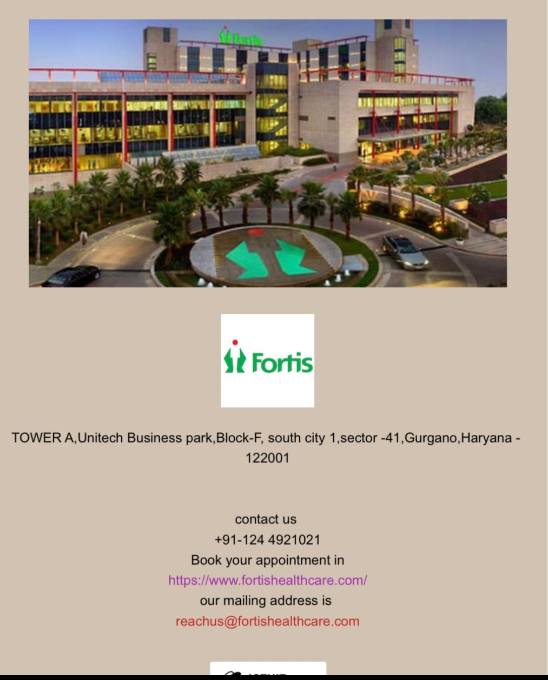
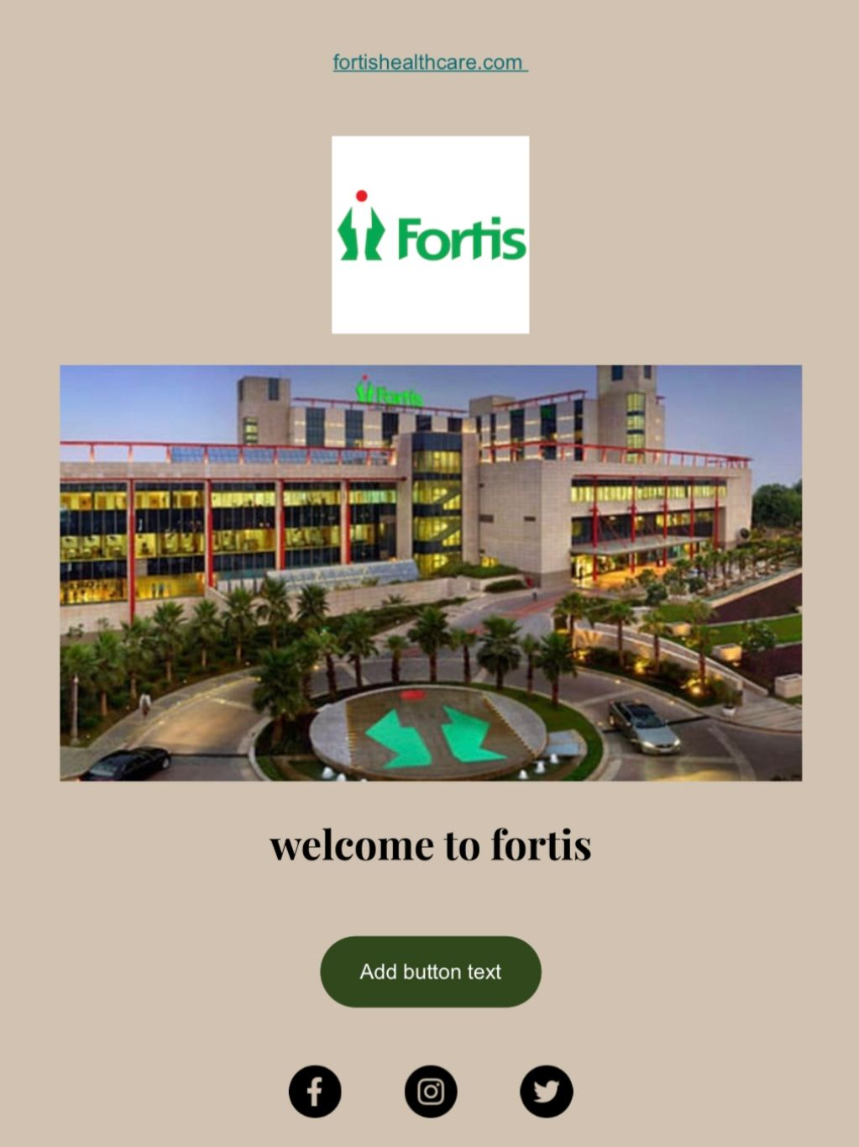
Email Ad Campaign 1 - Brand Awareness
(insert emailer image)

Slide 43
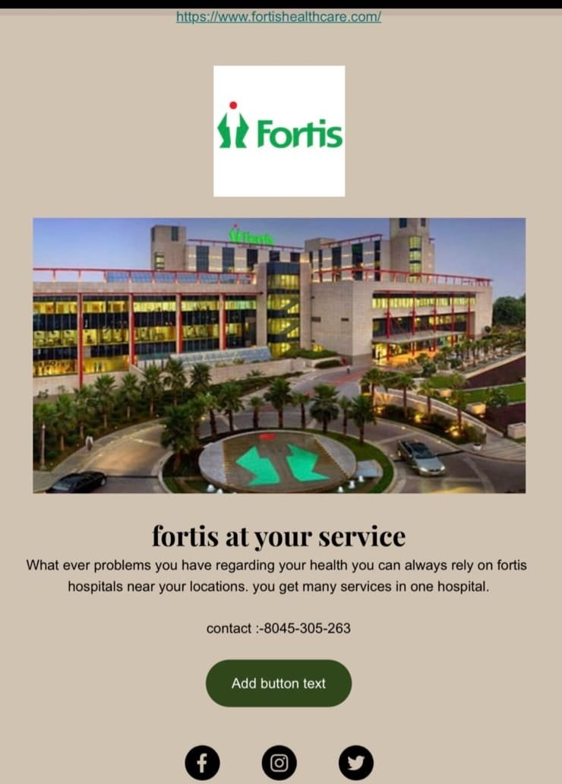
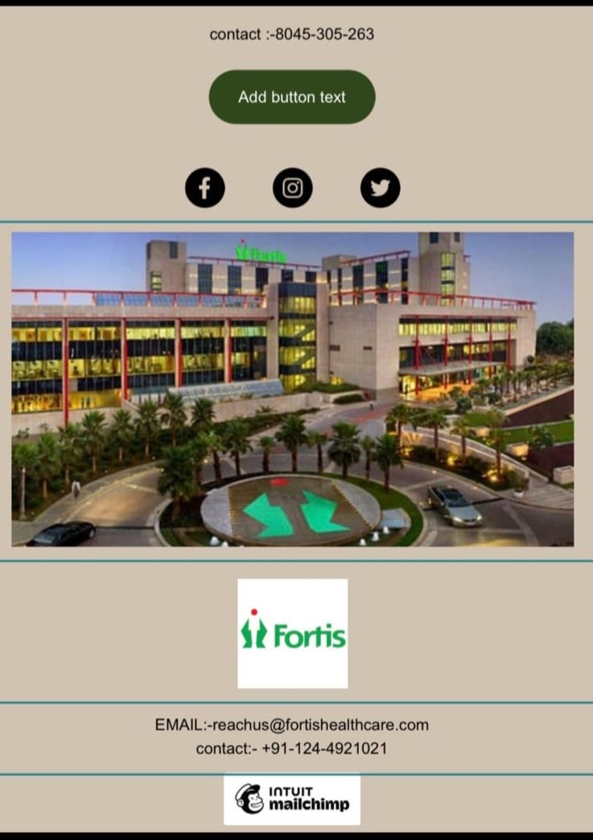
Email Ad Campaign 2 - Lead Generation
(insert emailer image)

Slide 44

Part 4: Content Creation and Curation (Post creations, Designs/Video
Editing, Ad Campaigns over Social Media and Email Ideation and Creation)
Reflect on the content creation and curation process, discussing the challenges faced and lessons learned.
Lessons learned:
We learned how to create social media business accounts and promote the product and services of a brand.
We also discovered how it has become easier to connect with the audience and share updates in less time.
We also understood that many companies are investing more in digital marketing to reach people.

Slide 45

Challenges faced:
We encountered many challenges while making social media ads there are fewer apps that can give a better experience in making the ads.
We also encountered a few of the companies that are not using attractive ad campaigns.
Few of them are misguiding the people by not showing original information.
Many of them are not maintaining their website information updated, so many people can’t know about the current product and services provided by companies until they visit their stores.

